Slide 1
Variation and Evolution
L:O= To be able to produce a flow diagram explaining evolution

Slide 2
Adaptation
What does this term mean?
Create a mind map explaining how a polar bear is adapted to it’s environment.

Slide 3
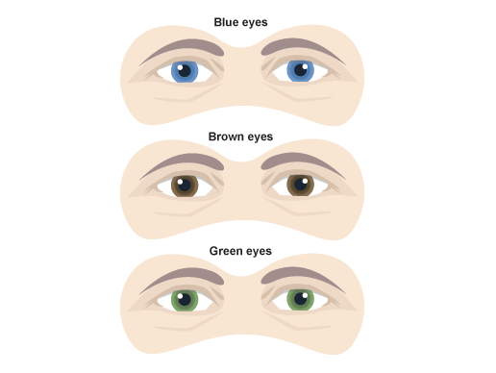
What is the difference between inherited and environmental variation?
List some examples of both types of variation.

Slide 4
Evolution
Variation, competition, adapted, survive, die, “survival of the fittest”, breed, pass on, offspring.
All species have variation. If there is lack of food there will be competition. Those that are well adapted to the environment are more likely to survive, the rest will die. This is the survival of the fittest. These organisms will breed and pass on the good variations to their offspring.

Slide 5
Using the corrections made on your work, in pairs, produce a flow chart explaining the theory in your books.

Slide 6
Questions
Explain how warfarin resistance evolved in rat populations.
Explain how a species may become extinct.

Slide 7
Plenary

